Slide 1
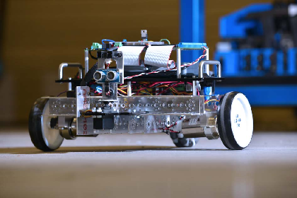
ECE4871: ECE Culminating Design I
Instructors:
Prof. Frazier-ECE, Prof. Shen-ECE

